Slide 1
Session 24
java.nio Package

Slide 2
Review
According to the sandbox theory, applets reside within a sandbox and are allowed to manipulate data only within the specified area on the hard disk.
A stream is a path traveled by data in a program.
When a stream of data is being sent or received, we refer to it as writing and reading a stream respectively.
The standard input-output stream consists of System.out, System.in, and System.err streams.
InputStream is an abstract class that defines how data is received.
InputStream provides a number of methods for reading streams of data as input.

Slide 3
Review Contd…
The OutputStream class is also abstract. It defines the way in which output is written to streams.
ByteArrayInputStream creates an input stream from the memory buffer while ByteArrayOutputStream creates an output stream on a byte array.
Java supports file input and output with the help of File, FileDescriptor, FileInputStream and FileOutputStream classes.
File class directly works with files on the file system. The files are named using the file-naming conventions of the host operating system.
FileDescriptor class provides access to the file descriptors that are maintained by the operating system when files and directories are being accessed.

Slide 4
Review Contd…
A buffer is a temporary storage area for data. Java uses buffered input and output to temporarily cache data read from or written to a stream.
The RandomAccessFile class provides the capability to perform I/O to specific locations within a file.
Character streams provide a way to handle character oriented input/output operations.
Reader and Writer classes are abstract classes that support reading and writing of Unicode character streams.
The CharArrayReader and CharArrayWriter classes are similar to ByteArrayInputStream and ByteArrayOutputStream in that they support input and output from memory buffers.
Serialization is the process of reading and writing objects to a byte stream.

Slide 5
Objectives
  Discuss the new I/O packages
  List the main features of this package
  Discuss the Buffer Class and its hierarchy
  Explain the methods in the Buffer class
  Describe the Channel class
  Discuss the use of Filechannel class with the FileInputStream and FileOutputStream
  Explore the class MemoryMappedFile
  Describe Channel-to-Channel connection

Slide 6
The New I / O Packages
The new I/O APIs, added to handle the I/O operations, support channel based approach to I/O operations.
These classes supplement the standard I/O classes found in java.io package.
The new I/O classes are present in five packages, namely: java.nio, java.nio.channels, java.nio.channels.spi, java.nio.charset, java.nio.charset.spi

Slide 7
Benefits of NIO
Buffers for primitive type data
Character set encoders and decoders
A pattern matching facility by using regular expression
Channels for open I/O connections
A file interface that supports file lock and memory mapping

Slide 8
New I/O System (NIO)
The new I/O system is based on two concepts: buffers and channels.
A buffer is a container to hold fixed amount of data.
A channel represents an open connection to an I/O device like file or socket.
A channel to an I/O device and a buffer to hold data on which I/O operations can be done have to be obtained.

Slide 9
Buffer Basics
We all know that buffers are temporary storage areas that hold data so that the data can be retrieved later and further stored.
All buffers are subclasses of the Buffer class and there is one buffer class for each of the primitive data types.
Only boolean primitive data type has no matching buffer class.
Methods of the Buffer class are common to all buffer types regardless of the data type.

Slide 10
Attributes Of Buffer
Capacity: It specifies the maximum number of elements that a buffer can hold.
Current Position: It specifies the index within the buffer at which the next read and write operation will take place.
Limit: It is the index of the end of the buffer.
Mark: It is a remembered position.

Slide 11
Example
import java.nio.*;
class CharBufferDemo
{
String strArray [] = {"She sails ", "sea sails", "on the sea shore", "Repeat it in one second"};
int pos = 0;
CharBuffer chbuf;
CharBufferDemo()
{
chbuf = CharBuffer.allocate(100);
/* The loop will get the content from
the String array one by one and
display the content before fetching
the next string from the String array
*/
while(fillbuf(chbuf))
{
// setting the position to ‘0’ so that one can start reading
//from the beginning of the buffer
chbuf.flip();
drain(chbuf);
// Clear the buffer
chbuf.clear();
}
}
// this method receives the contents of String array
// one by one and fills the buffer
boolean fillbuf(CharBuffer tempbuf)
{
if(pos >= strArray.length)
{
return false;
}
String nextString = strArray[pos++];
for(int count = 0; count < nextString.length(); count++)
{
tempbuf.put(nextString.charAt(count));
}
return true;
}
void drain(CharBuffer tempbuf)
{
while(tempbuf.hasRemaining())
{
// Display the content of the buffer
System.out.print(tempbuf.get());
}
System.out.println();
}

Slide 12
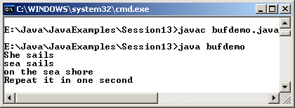
Example Contd…
public static void main(String [] arg) throws Exception
{
CharBufferDemo obj = new CharBufferDemo();
}
}
Output

Slide 13
equals() and compareTo()
The equals() method is used for testing the equality of buffers and compareTo() is used for comparing buffers.
compareTo() method returns an integer that is negative, zero or positive if the buffer argument is less than, equal to and greater than the buffer object on which the method was called.
Two buffers are considered equal if the following rules are satisfied
  Both objects are of the same type. Buffers of different data types are not equal.
  Both buffers have the same number of remaining elements.
  When get() method is called, the sequence of receiving the data elements is the same.

Slide 14
Channels
Channels represents an open connection to an I/O source or destination such as a hardware device, a file, a network socket or a program component that is capable of performing one or more distinct I/O operations.
Channel APIs are specified by interfaces.

Slide 15
Channels Contd…
There are two methods in the channel interface:
  public boolean isOpen(): This method checks to see if a channel is open
  public void close ( ) throws IOException: It closes an open channel.

Slide 16
Channels Contd…
Channels operate only on byte buffers and transfer data to and from ByteBuffers objects.
Channels act as conduits to I/O services.
Broadly there are two types of I/O: file I/O and stream I/O.
There are also two types of channels: file and socket.
There is only one FileChannel class and three socket channel classes. They are SocketChannel, ServerSocketChannel, and DatagramChannel.

Slide 17
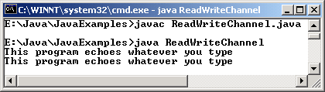
Example
import java.nio.*;
import java.nio.channels.*;
import java.nio.channels.Channels;
import java.io.*;
class ReadWriteChannel
{
public static void main(String [] args) throws IOException
{
ReadableByteChannel rbcRead = Channels.newChannel(System.in);
WritableByteChannel wbcWrite = Channels.newChannel(System.out);
chcopy(rbcRead, wbcWrite);
rbcRead.close();
wbcWrite.close();
}
static void chcopy (ReadableByteChannel src, WritableByteChannel dest) throws IOException
{
ByteBuffer buf = ByteBuffer.allocate(1000);
while(src.read(buf) != -1)
{
// reset the buffer
buf.flip();
// Write until there exist a byte in the buffer
while(buf.hasRemaining())
{
dest.write(buf);
}
//clear the buffer
buf.clear();
}
}
}
Output

Slide 18
Closing channels
An open channel represents a specific connection to a specific I/O service and encapsulates the state of that connection.
Once the channel is closed, the connection is lost and the channel is no longer connected.
The syntax is
  void close() throws IOException
When the close() method is called, the thread is blocked temporarily while the channel finalizes the closing of the underlying I/O services.

Slide 19
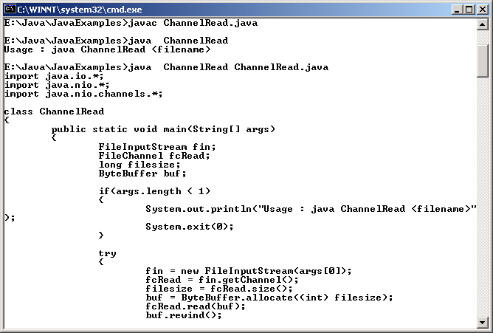
Example
Output
import java.io.*;
import java.nio.*;
import java.nio.channels.*;
class ChannelRead
{
public static void main(String[] args)
{
FileInputStream fin;
FileChannel fcRead;
long filesize;
ByteBuffer buf;
if(args.length < 1)
{
System.out.println("Usage : java ChannelRead <filename>");
System.exit(0);
}
try
{
fin = new FileInputStream(args[0]);
fcRead = fin.getChannel();
filesize = fcRead.size();
buf = ByteBuffer.allocate((int) filesize);
fcRead.read(buf);
buf.rewind();
for(int count = 0; count < filesize; count++)
{
System.out.print((char) buf.get());
}
System.out.println();
fcRead.close();
fin.close();
}
catch(IOException e)
{
System.out.println(e);
System.exit(0);
}
}
}

Slide 20
File Locking
This is a facility which has been added in JDK 1.4 release.
The locks can be shared or exclusive.
Not all operating system and file system support shared lock, in such cases it will behave like an exclusive lock.
If you lock a region after the end of file and if the file grows beyond that area then lock will cover the new area.
If a region is locked and if the file grows beyond that region then the new content will not be locked.

Slide 21
Memory- Mapped Files
The map() method in the FileChannel class establishes a memory mapping between an open file and a special type of ByteBuffer.
The MappedByteBuffer object that is returned from the map() method call, behaves like a memory based buffer but the data elements are actually stored in a file on a disk.
Accessing a file through memory mapping is more efficient than accessing it by conventional means because virtual memory system of the operating system caches the memory pages and thus the contents can be accessed at high speed without the need to make any system call to get the data.

Slide 22
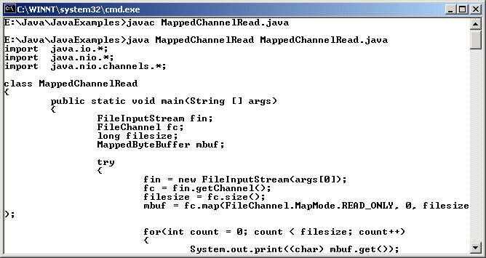
Example
for(int count = 0; count < filesize; count++)
{
System.out.print((char) mbuf.get());
}
System.out.println();
fc.close();
fin.close();
}
catch(IOException e)
{
System.out.println(e);
System.exit(0);
}
}
}
Output
import java.io.*;
import java.nio.*;
import java.nio.channels.*;
class MappedChannelRead
{
public static void main(String [] args)
{
FileInputStream fin;
FileChannel fc;
long filesize;
MappedByteBuffer mbuf;
try
{
fin = new FileInputStream(args[0]);
fc = fin.getChannel();
filesize = fc.size();
mbuf = fc.map(FileChannel.MapMode.READ_ONLY, 0, filesize);

Slide 23
Channel to Channel Transfer
We can transfer data from one channel to another channel without passing it through an intermediate buffer by using the methods transferTo() and transferFrom().
These methods are found in FileChannel class and so one of the channel involved in transfer should be of FileChannel class.

Slide 24
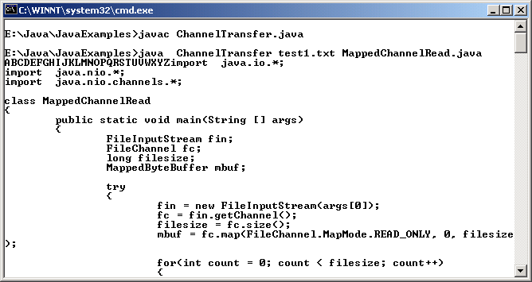
Example
import java.io.*;
import java.nio.*;
import java.nio.channels.*;
class ChannelTransfer
{
public static void main(String [] args) throws Exception
{
if (args.length == 0)
System.out.println("Usage : java ChannelTransfer <filename1> <filename2>");
concatFile(Channels.newChannel(System.out), args);
}
static void concatFile( WritableByteChannel targ , String [] filenames) throws Exception
{
for (int count = 0; count < filenames.length; count++)
{
FileInputStream fis = new FileInputStream(filenames[count]);
FileChannel fc = fis.getChannel();
fc.transferTo(0, fc.size(), targ);
fc.close();
fis.close();
}
}
}
Output

Slide 25
Summary
The new I/O classes are present in five packages.
The new I/O system is based on two concepts: buffers and channels. A buffer is a container to hold fixed amount of data. A channel represents an open connection to an I/O device like file or socket.
Buffers have four attributes: Capacity, Current Position, Limit and Mark.
Channel API’s are specified by interfaces. There are two methods in the channel interface: isOpen() and close().
Channel act as a conduits to I/O services.

Slide 26
Summary Contd…
There are two types of channels: file and socket. There is only one FileChannel class and three socket channel classes: SocketChannel, ServerSocketChannel and DatagramChannel.
File locking facility has been added in JDK 1.4. The locks can be shared or exclusive.
The map() method in the FileChannel class establishes a memory mapping between an open file and a special type of ByteBuffer.
Once an area has been mapped it will remain so until and unless the MppedByteBuffer object is garbage collected.
The transferTo() and transferFrom() enables data to be transferred from one channel to another channel without passing it through an intermediate buffer.

